Slide 1
Vue.js

Slide 2
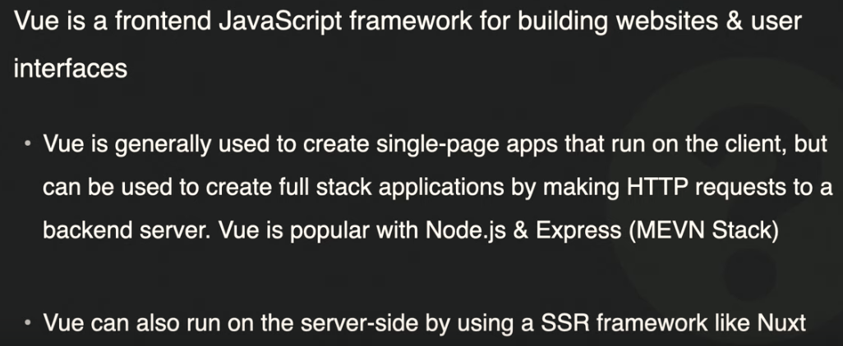
What is Vue?

Slide 3
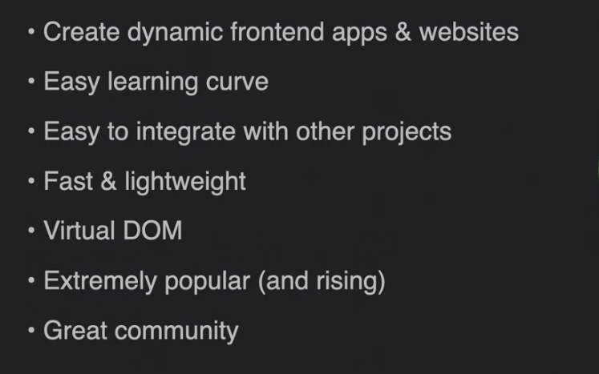
Why Use Vue ?

Slide 4
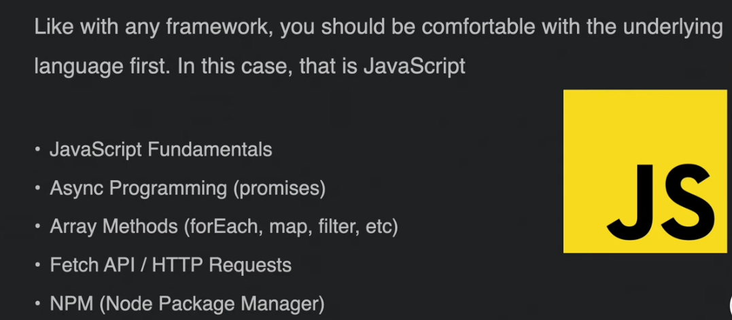
What should you know first ?

Slide 5
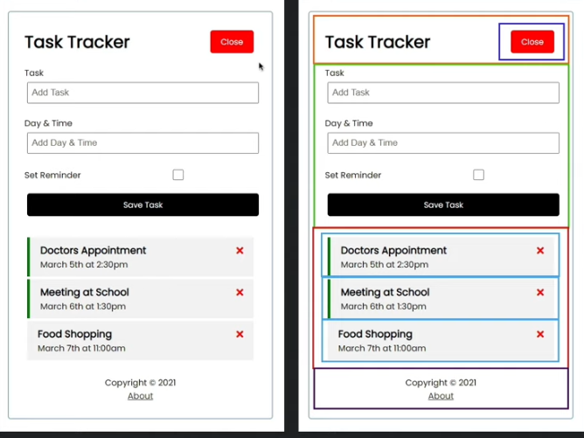
UI Components

Slide 6
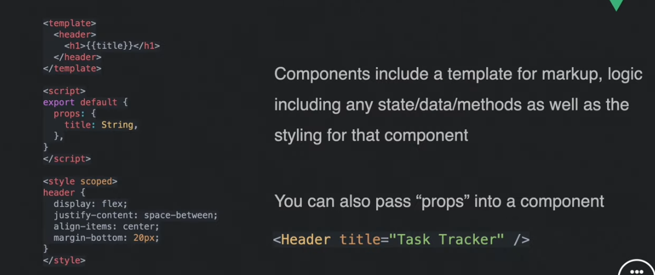
Basic Layout Of a Vue Component

Slide 7
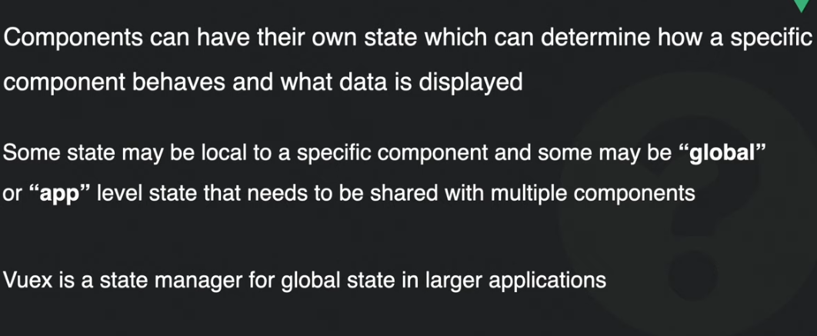
State in Vue

Slide 8
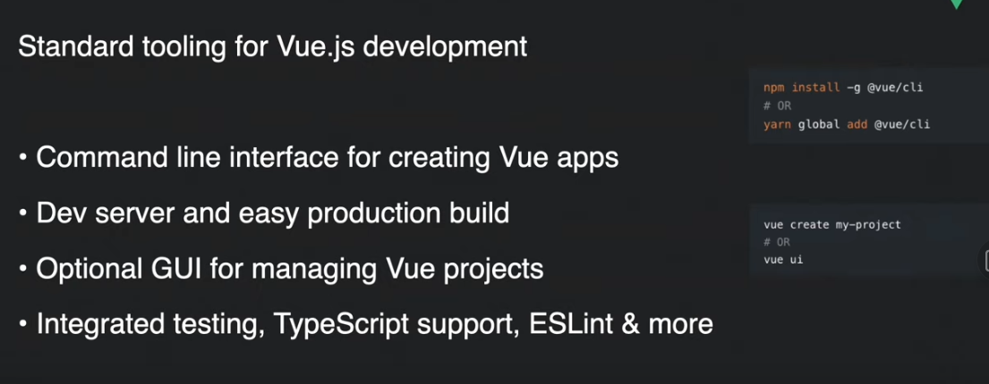
Vue CLI

